Slide 2
Intellectual Property and AI
The recent explosion of popularity in LLMs has led to a number of lawsuits and open debates around the ways in which AI systems impact intellectual property.
We’ll use the current lawsuit between OpenAI and the New York Times as a grounding point for discussion.

Slide 3
OpenAI vs NYT
There are three potential places where OpenAI may have violated the New York Times’ copyright:
Training on data that they did not own.
Constructing an intermediate representation based on the NYT content.
Emitting results that are identical to content in the NYT.
While these might seem obvious at first glance, they’re actually quite complicated.

Slide 4
Protecting Intellectual Property
Intellectual property is a work that is the result of creative activity or ideas.
Books, songs, manuscripts, computer programs, poems, slogans, artwork, movies, video games, processes, designs, symbols, and more.
There are several ways to protect intellectual property, depending on its nature.

Slide 5
Copyright
Creative works, such as books, movies, songs, computer programs and plays can be copyrighted.
Goal: give the artist exclusive rights to reproduce the work.
Copyright owners can license their work for a fee, permit or prohibit public performances, and allow or prohibit adaptations.
The expression, not the idea, is copyrighted.
Exceptions: fair use.
Works that are no longer copyrighted are in the public domain.
Challenge: extended copyright periods == diminished public domain

Slide 6
Fair Use
Copyright has exceptions. These are based on four criteria:
Character and purpose. Is it commercial or non-profit? Is it transformative? Does the new work add something new or different?
Parody and satire often fall in here.
Is the original work fiction or non-fiction? Is the original work published?
How much is taken from the original work?
What is the effect on the market for the original work?

Slide 7
Common Fair Use examples
Reviews and commentary
Reviewers can include excerpts from works they are discussing.
Parody and satire
It’s understood that this does not harm the market for the original item.
Educational materials
Universities typically pay licensing fees for course readers, etc.

Slide 8
Some interesting Fair Use cases
Campbell vs Acuff-Rose. The “2 Live Crew” case.
2 Live Crew’s work was found to be transformative, and therefore fair use.
Authors Guild vs Google
Google indexed copyrighted books without permission. Only small snippets were provided to users. This was found to be transformative, and therefore fair use.
Google vs Oracle.
Google reproduced 11,500 lines from the Java API, in order to provide interoperability.
Found to be fair use – transformative, “sought to create new products”, “promote innovation.”

Slide 9
Some interesting Fair Use cases
Sega vs Accolade
Accolade reverse-engineered the Seg Genesis in order to learn how to make games for it.
Sony vs Connectix.
Connectix reverse-engineered Sony Playstation software in order to develop a third-party console that could play Playstation games.
This was considered fair use.
“Intermediate copying” - a copy is created, but only as a means to a non-infringing application.

Slide 10
Public Domain
Once the copyright expires on a work, it is in the public domain.
It belongs to everyone, and no permission is needed to use or reproduce it.
Shakespeare, The Bible, Charles Dickens, Moby Dick, Mozart, Beethoven, Michelangelo, and many more.
The extension of copyright terms has led to stranded works.
Not in the public domain, but no longer published.

Slide 11
Patent
A patent is an exclusive protection on a specific invention.
The patent holder can exclude others from making or selling their invention. They can also sell the rights.
Limited time period: 20 years in US.
Only the specific invention or process is patented.
Purpose: incentivizes innovation.
Challenge: patent trolls, capture of IP.

Slide 12
Trademark
A trademark is a sign, design, logo or phrase that identifies a product or company.
Mickey Mouse, the Apple logo, “Just Do It”
Meant to protect the look or identity of a product.
A company can register a trademark as property.
Exceptions for fair use, comparison, market scope.

Slide 13
What is a software license?
Software is copyrighted. A license gives some of these rights to the user.
A software license specifies what you, the user of the software, have the right to do (and not do).
It’s intended to:
Articulate your rights as a user
Protect the rights of the creator

Slide 14
Commercial licenses
Commercial licenses typically greatly restrict your rights.
Cannot:
Make multiple copies or circumvent copy protection
Modify the program
Extend the program
Redistribute the program
You don’t own the program - you’re just using it.

Slide 15
“Open”
In some cases, the creator of software might want to grant more rights to users. For example:
The right to perform (if it’s scripted)
The right to display the software to others
The right to make copies
The right to distribute copies
The right to make changes to the program
The right to create derivative works
Broadly speaking, these ideas form the basis of open-source software.

Slide 16
Creative Commons
You might also want to restrict usage according to purpose.
“You can use my work, but you can’t charge money for it.”
“You can use my work, but you have to share whatever you come up with”
”You can use my work, but you have to give me credit.”
Creative Commons provides a set of flexible licenses for specifying how intellectual property can be shared.

Slide 17
“Open” ______
The open source concept has extended to other types of intellectual property.
Music
Graphics
Websites and repositories (wikis, etc)
Organizational Structures
Film
Documents
Idea: begin from a perspective that openness and sharing is the default.

Slide 18
Open Source
Open source software releases the source code, while specifying some or all of the rights described above.
Do you know any open source software?

Slide 19
Open Source
Open source software releases the source code, while specifying some or all of the rights described above.
Do you know any open source software?
Linux, Apache Web Server, Firefox, Thunderbird, Java, Python, Perl, MySQL, Drupal, WordPress, Arduino, Blender, Unity, Handbrake …
Most of the tools that make the internet work are open source.

Slide 20
Why make your project open?
So why would someone choose to make their project open?

Slide 21
Why make your project open?
So why would someone choose to make their project open?
Build user base
Encourage developer community
Support open culture
Transparency
Support educational, nonprofit adoption
Built on previous open-source projects

Slide 22
Back to Fair Use …
The Google Books case is very instructive for our purposes.
It’s a situation in which a company is using copyrighted work not to create copies, but to develop a new application.
To understand this better, we need to learn a little bit about how the WWW is archived.

Slide 23
History Lesson: Archiving the Web
1993: The World Wide Web is developed.
A worldwide, fully digital, decentralized information network.
Right away, two questions came up:
How can we find things?
How can we preserve things?

Slide 24
History Lesson: Archiving the Web
Finding things led to the development of search engines.
Roughly speaking, a search engine consists of two components:
Collection. How do you find all the pages on the web?
Start with an initial set; get all the pages they link to. Then get all the pages they link to. And so on …
This is called a crawl
Lots of fun problems to solve here:
Detecting duplicates, broken sites, sites that don’t want to be crawled …

Slide 25
History Lesson: Archiving the Web
Finding things led to the development of search engines.
Roughly speaking, a search engine consists of two components:
Indexing. For each page, extract the words that are most relevant and create an index that maps those words to the pages they came from.
“cat”
http://catpics.com
Search is then a problem of getting the pages mapped to by the keywords and ordering them.

Slide 26
Open Datasets
As search engines were maturing, a need for open crawls developed.
These are open, freely available web crawls.
Useful for studying the web, detecting spam, creating offline archives, building new tools, preserving content, and more.
These crawls are also very useful for training machine learning models.

Slide 27
Creating open datasets for pretraining
Pretraining is the process of ingesting large amounts of data and learning statistical patterns among words.
No classes are being learned.
Big insight in LLMs: You can pretrain on a very large, general dataset and then finetune on more specialized data to perform specific tasks.
Pretraining datasets include:
Common Crawl
The Pile
Gutenberg Project

Slide 28
Pretraining dataset qualities
Language – English and Chinese are the most common
Domain (news, chat, social media, code, books, etc)
Duplicates removed?
SEO pages removed?
Harmful content removed?

Slide 29
Open Datasets for fine-tuning
Fine-tuning is the process of training an LLM on a particular task, such as answering questions or summarizing text. It looks more like the machine learning we saw with Teachable Machine.
SFT - Supervised fine-tune.
Contains questions, answers, context
RLHF – Reinforcement learning with human feedback
Contains questions, answers, human score
Helpful and Harmless (Anthropic)
Fine-tunes the model to avoid problematic or offensive responses.
Chain-of-Thought
Shows the model how to generate sequences of responses.

Slide 30
Back to OpenAI
Where does OpenAI get its training data?
OpenAI’s large language models, including the models that power ChatGPT, are developed using three primary sources of information: (1) information that is publicly available on the internet, (2) information that we license from third parties, and (3) information that our users or our human trainers provide.
How might NYT content have wound up in OpenAI’s training set without their directly circumventing the paywall?

Slide 31
Back to OpenAI
How might NYT content have wound up in OpenAI’s training set without their directly circumventing the paywall?
Google caches
Allows search engines to index paid content.
Quotes on third-party sites
Other archives

Slide 32
Is training a copyright violation?
OpenAI will likely argue that this is fair use.
Training an LLM is transforming, like Google Books, they may claim.
They may also argue that they only trained on content that was publically available.
They will also argue that it’s not possible for the NYT to look at the insides of an LLM and see the infringing content.

Slide 33
Can LLM outputs violate copyright?
This may be more difficult for OpenAI.
They might try to argue that there is no demonstrated financial harm to the NYT, or that this is fair use.
OpenAI also argues that using their tools to break the law is a violation of their terms of service.

Slide 34
Question!
Suppose that OpenAI takes our class on as a client.
How would you advise them to proceed so as to avoid losing a lawsuit?
Technical solutions?
Legal solutions?

Slide 35
Question!
Suppose that Gavin Newson calls us for our advice on how to write new legislation surrounding LLMs.
What issues would you recommend that he pay attention to?
Who are the different stakeholders that we should consult?

Slide 36
Optopia
Back to optopia again.
Moving forward from here, what does a better world look like?
What can we put in place to help move there?

Slide 37
Break

Slide 38
So how does this stuff work anyway?

Slide 39
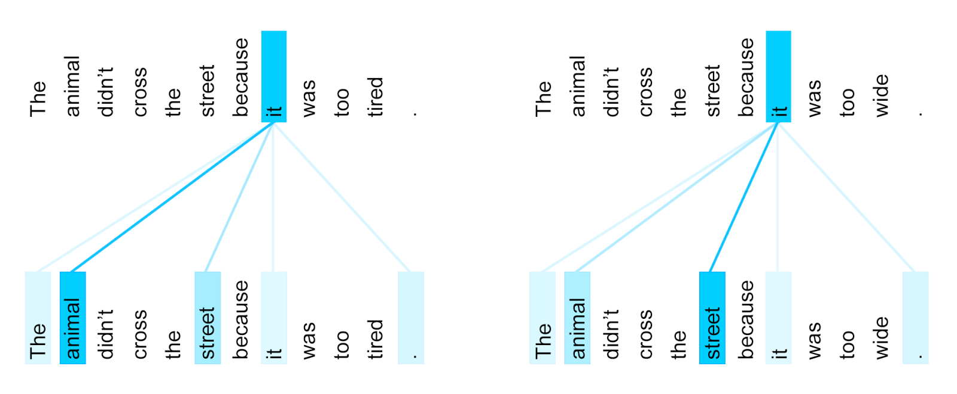
How does this stuff work?
The transformer is a kind of neural network (a particular AI architecture)
It’s really good at mapping inputs to outputs.
Originally designed for translation.
Turns out to also be really good at generating new inputs that are “like” the ones it’s seen.
Key idea: the transformer does not have any internal model or understanding.
The transformer adaptively pays attention to particular words based on the word being processed.

Slide 40
Large Language Models
To make this work, we need lots of data in order to learn complex relationships between combinations of words
Massive datasets, lots of data cleaning and preprocessing needed.
Some languages are more well-represented than others.
This final statistical relationship between words is called a large language model.
“The _______ and fluffy cat”
The orange and fluffy cat ______”
“The orange and fluffy cat” -> “el gato naranja esponjoso”

Slide 41
ChatGPT, Gemini, et al
LLMs are at the core of these tools.
They are trained using human reinforcement to get really good at the task of “given this input, what’s the next sequence of tokens?”
Insights:
Training on essentially all of written human knowledge allows for the discovery of complex relationships.
No “internal model” or common-sense knowledge.
Many common tasks require a small subset of this knowledge
Guiding users towards tasks that LLMs do well at is important.

Slide 42
LLMs vs Search Engines vs Wikipedia
Search engine:
Crawls the web to find actual documents and stores them.
When you search, tries to match your query to the stored documents.
Results are as true as the documents being stored.
Just because something is on the web doesn’t make it true!
LLM:
Trained using a huge collection of documents.
Only statistical relationships between words are stored.
When you prompt, it generates a sequence of strings deemed the most likely response.
No ground truth! There is not necessarily an actual document being referenced.*
Wikipedia:
Crowd-sourced encyclopedia
Truth is verified through community volunteers
*Fixing this is a primary goal of most LLMs

Slide 43
Image Generation
What about image generation?
We start with a similar idea – we need a generative model.
Where do we get that?

Slide 44

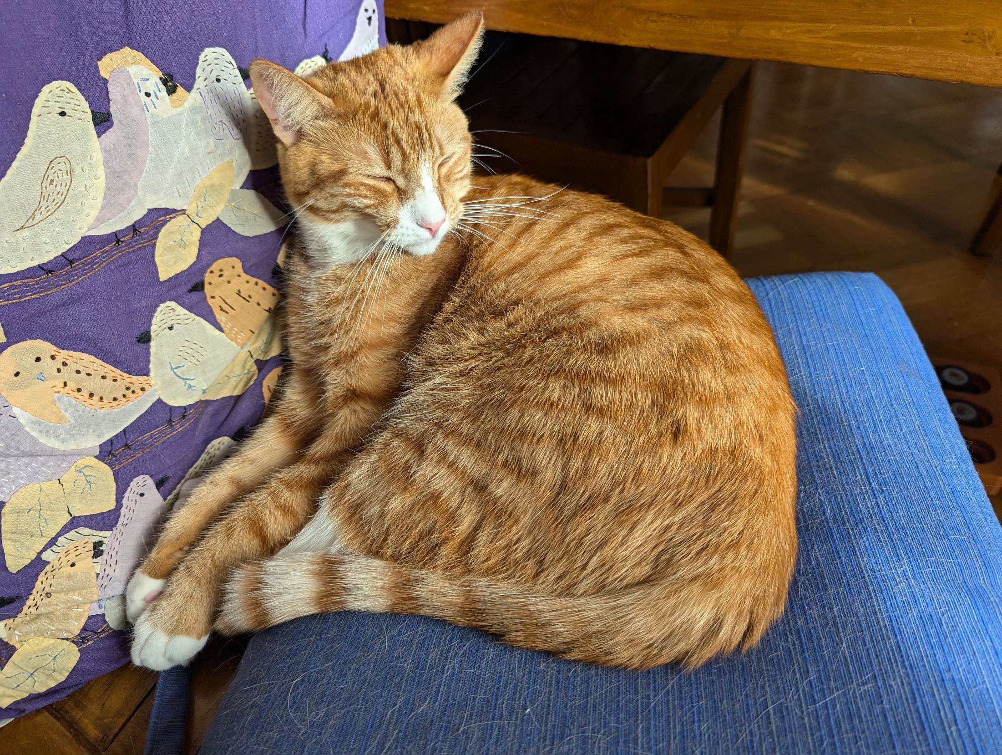
Reminder: pixels
Images are comprised of a large number of pixels.
A pixel can be thought of as a set of numbers <x,y,z> representing the color at that point.
<x,y,z> are usually the red, green, and blue in that color.
That means that we can think of a picture as an array of features, each of which is a pixel.

Slide 45

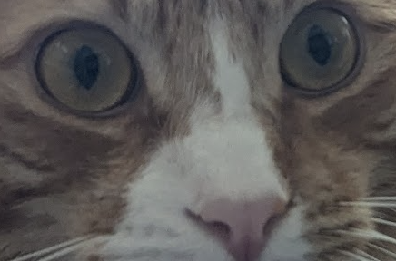
Classifying images
What is being learned?
Low-level relationships between pixels
Are composed into higher-level features
Note: We have redefined the problem from
”is that a cat” to “does this collection of pixels meet a threshold.”
And then relationships between these features are induced.
Pictures with this set of relationships between features are placed into the class “Obi-wan”.

Slide 46
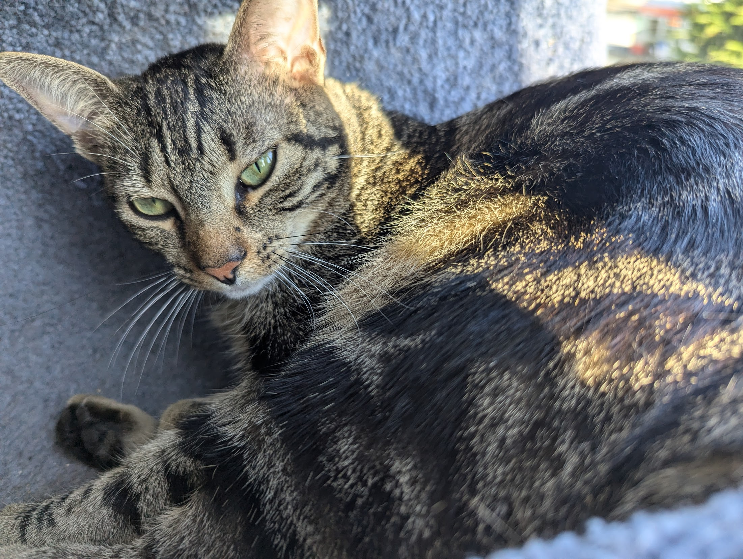
Image generation
Classifier
”Obi-Wan”
What if we took our image classifier …

Slide 47
Image generation
Generator
”Obi-Wan”
And ran it in reverse?
Then, for different classes of cats, we could make cat pictures!

Slide 48
Embeddings
Deep learning systems don’t work with text or images directly.
Too informationally dense.
Instead, they map their inputs into a smaller, more well-structured space.
This is called an embedding.
Embeddings allow different tools to connect to each other.

Slide 49
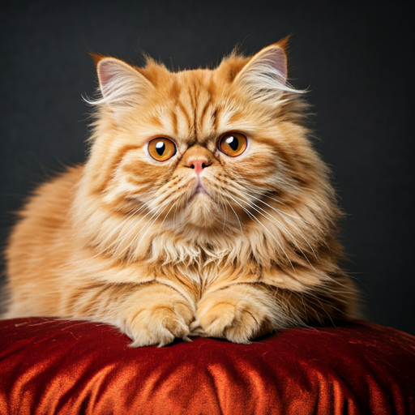
Image generation
LLM
generator
”Orange fluffy cat”
embedding

Slide 50
Comments
The trick is in connecting the prompt to a point in the space of images that are “correct.”
There’s no intentionality to what’s generated. Yet training on massive datasets can produce impressive results.
The lack of higher-order knowledge leads to issues like weird fingers; the generator is not “drawing a picture” but rather choosing pixels that are associated with other pixels given proximity to the prompt.

Slide 51
Incorporating knowledge
A core challenge with deep learning systems is their lack of higher-order knowledge.
This is not necessarily the case with other AI systems.

Slide 52
Levels of Knowing
Data is not information
Information is not knowledge
Knowledge is not understanding
Understanding is not wisdom

Slide 53
Levels of Knowing
Data is not information
Information is not knowledge
Knowledge is not understanding
Understanding is not wisdom.

Slide 54
Levels of Knowing
Data is not information
Information is not knowledge
Knowledge is not understanding
Understanding is not wisdom.
What is data?
Facts, statistics, numbers, words, pictures, movies, sounds…
Blood pressure readings, patient charts, x-rays, dates, times…

Slide 55
Levels of Knowing
Data is not information
Information is not knowledge
Knowledge is not understanding
Understanding is not wisdom.
What is information?
Information is data that tells us something we didn’t know before
Patient’s name, increase in blood pressure, dark area on image.

Slide 56
Levels of Knowing
Data is not information
Information is not knowledge
Knowledge is not understanding
Understanding is not wisdom.
What is knowledge?
Knowledge is a way of arranging information.
Patient is a 54-year-old female with a history of hypertension. She is experiencing indigestion and dizziness.

Slide 57
Levels of Knowing
Data is not information
Information is not knowledge
Knowledge is not understanding
Understanding is not wisdom.
What is understanding?
Understanding is the ability to integrate knowledge and draw inferences.
Patient is a 54-year-old female with a history of hypertension. She is experiencing indigestion and dizziness.
These symptoms are consistent with hypertension, but also with heart attack. Heart attack and hypertension are also related. The patient’s age also suggests heart attack as a possibility.

Slide 58
Levels of Knowing
Data is not information
Information is not knowledge
Knowledge is not understanding
Understanding is not wisdom.
What is wisdom?
Wisdom is knowing how to apply understanding to achieve an outcome.
Given the risks associated with heart attack, the patient should be admitted to a hospital immediately and given aspirin to reduce clotting.

Slide 59
Levels of Knowing
Depending on the application, we may be comfortable with different levels of AI assistance.
In a medical setting, I’m comfortable with a computer generating information and knowledge, but I would prefer a human to bring in understanding and wisdom.
In a less risky setting (say vacuuming my house) I might be willing to delegate higher levels of knowledge to an AI assistant.

Slide 60
Human-centered AI
Human-centered AI is simply the idea that the design of AI systems needs to place human needs at the core of the design process.
What is the human need or problem being addressed?
How will this AI system reduce suffering or make human lives easier?
These are different goals from maximizing efficiency, increasing profit, or reducing costs, which place the business at the center of the design process.

Slide 61
Human-centered AI ethics
This change in frame presents an opportunity for a new way of thinking about AI ethics.
Away from “do no harm” to “also do good”
How does this interface with modern capitalism?
Bostrom’s “superintelligence” consumes the planet to make paperclips.
Can we as humans conceive of a world in which maximizing consumption is not the implicit goal?
Might an AI be wise enough to recognize the fallacy of infinIte growth?

Slide 62
lunch

Slide 63
Card scenario – Construct your own future
Phase 1: Runaway Future.
This is a scenario in which AI is not managed effectively.
Draw cards for:
Intended Use
Human Actor
Technology Type
Runaway Risk
Or use your own ideas.
Flesh this out into a scenario.

Slide 64
Card scenario – Construct your own future
Phase 2: a non-runaway future. In this case, humanity manages this problem semi-effectively.
Draw cards for:
Technology type
Intended use
Potential Benefit
Potential Risk
Human Actor
Or use your own ideas.
Again, flesh this out. What is your positive scenario?

Slide 65
Card scenario – Construct your own future
Phase 3.
Now we’ll think about the sorts of things that we might do to get to the good outcome or avoid the bad outcome.
For both scenarios, add an Action Lever and a Mental Model.
For the runaway future, how will these help to avoid the problems you predicted?
For the non-runaway future, how will these help achieve our goals?

Slide 66
Card scenario – Construct your own future
Storytelling
Lastly, think about your scenarios. How would you (or someone else) create works that promote these ideas?
How would you suggest getting people to think about the scenario you’ve laid out, put more details onto it, and maybe even make it a reality?

